Slide 2


WELCOME TO
SYSTEM ANALYSIS
AND DESIGN
Presentation
UNIVERSITY OF ASIA PACIFIC
Department Of CSE Course Code: 306

Slide 3



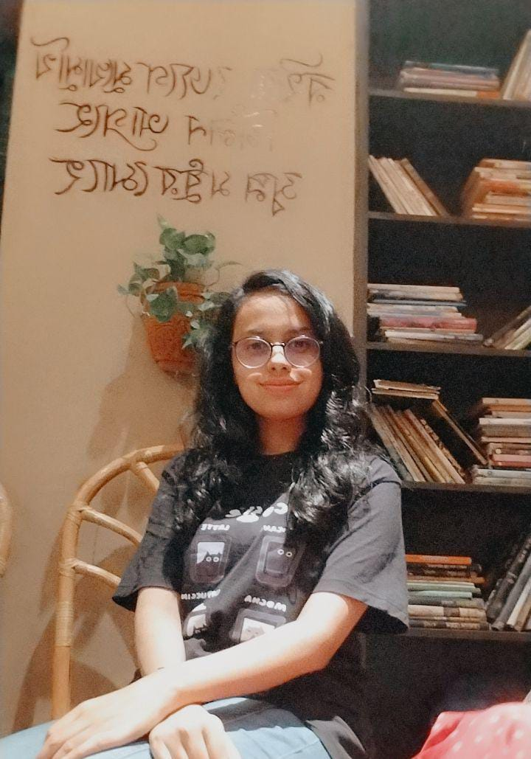

Instructor
Muhtasim Noor Alif
Team Members
Maria Akter Khushi
21201107
Ritu Rani Banik
21201108
Jannatul Ferdousi
21201114
Nur Habibah Binte Mahbub
21201103

Slide 4

Project Proposals :
1
AI Shopping System
2
Credit card fraud detection
3
Residential Security Monitoring System

Slide 5

AI Shopping System

Slide 6




Problem Definition:
Tailored Suggestions
Security and Fraud Detection
Optimization of the Supply Chain
Localized Market Insights

Slide 7









Motivation:
Global Competitiveness
Enhancing Customer Experience
Job Creation and Skill Development
Increasing Efficiency
Adapting to Changing Consumer Behaviors
Boosting Local Economy
Stimulating Innovation
Fighting Fraud

Slide 8








Solution:
Collaborative Partnerships
Data Accessibility
and Security
Talent
Development
Adaptation to
Local Context
Regulatory Framework
Infrastructure Investment
Consumer Education
Continuous Monitoring and Evaluation

Slide 9

Credit card fraud detection

Slide 10



Problem Definition:
Identification of suspicious events and prevention of fraudulent credit card transactions are the goals of the credit card fraud detection system.
Real-time transaction data analysis is done by this technology to differentiate between authentic and fraudulent activity.
Its key objective is to preserve a seamless user experience while reducing financial losses for cardholders and financial institutions.

Slide 11
Motivation:
Data Security
Financial Loss
Prevention
6
1
Reputation
Management
Motivation
2
Customer Trust and Confidence
5
Competitive
Advantage
4
3
Regulatory Compliance

Slide 12








Solution:
data collection
real-time analysis
preprocessing
decision-making
feature extraction
alerting
model training
reporting

Slide 13
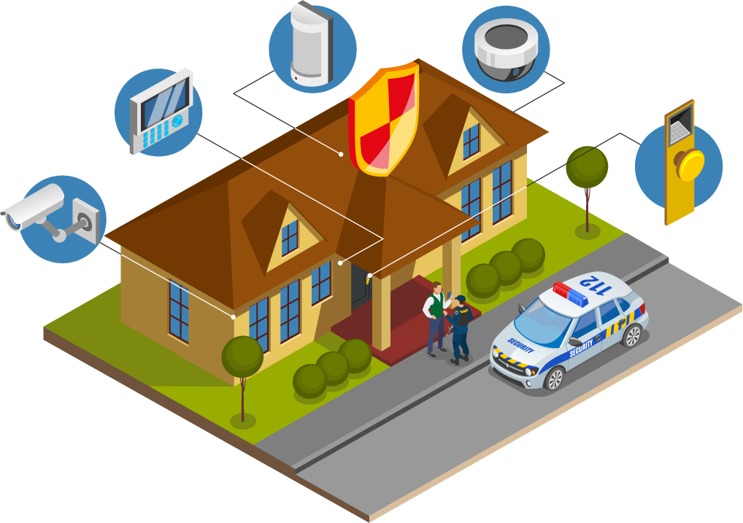
Residential Security Monitoring System

Slide 14
Problem Definition:
Limited Surveillance Coverage
Delayed Response to Security Threats
Existing residential security systems often have blind spots, leaving certain areas vulnerable to unauthorized access and criminal activities.
Lack of real-time monitoring capabilities results in delayed responses to security threats or emergencies, diminishing the overall effectiveness of the security system.
Integration Challenges with Smart Home Devices
Incompatibility issues and lack of standardized protocols hinder seamless integration with other smart home devices, limiting the comprehensive effectiveness of the security ecosystem.

Slide 15

Motivation:
Rising Security Concerns
Customized Security Solutions
Protecting Residents and Assets

Slide 16



Solution:
Advanced Surveillance and Identification
Cargo Inspection for Enhanced Security
1
2
Real-time Monitoring and Alerts
3
Resident Information Database
Integration and Scalability
4
5

Slide 17
Thank You!!

